Slide 1
Business Analytics Project for e-commerce company
Carlos Gallegos

Slide 2
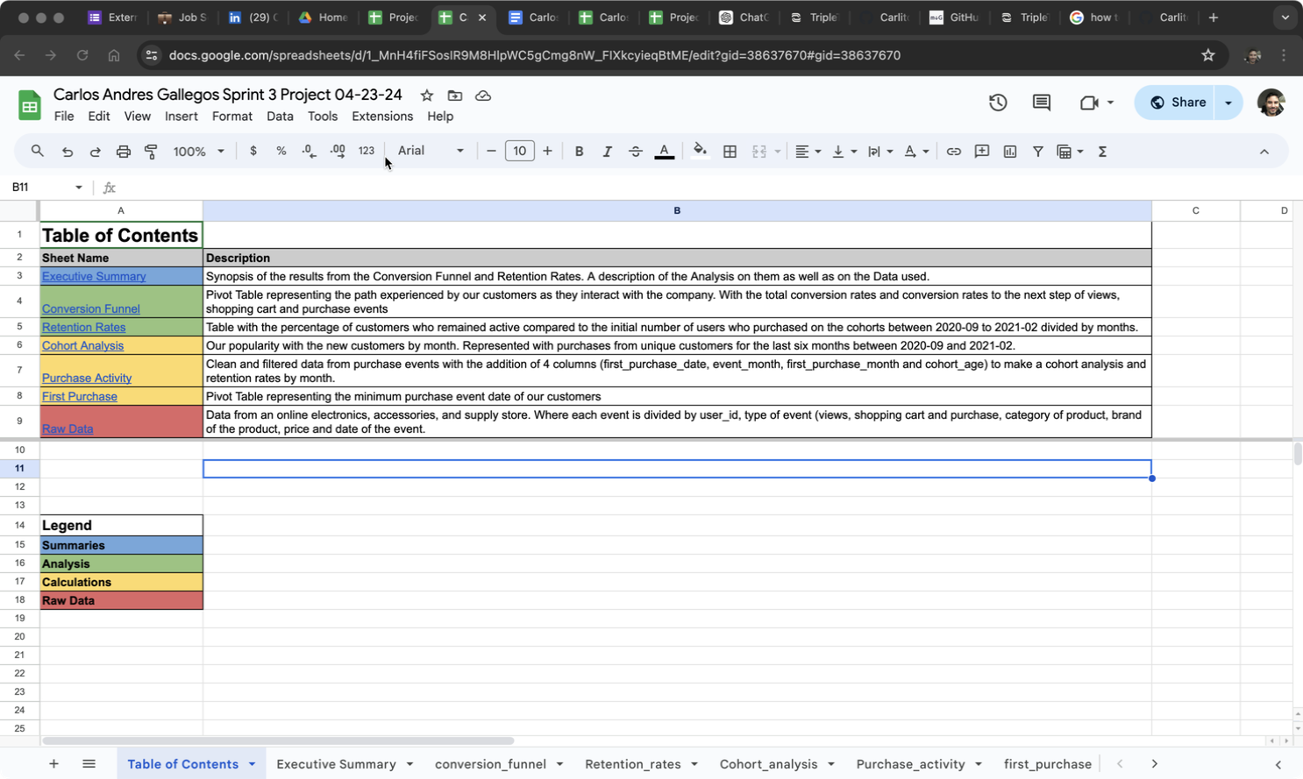
Table of Contents

Slide 3
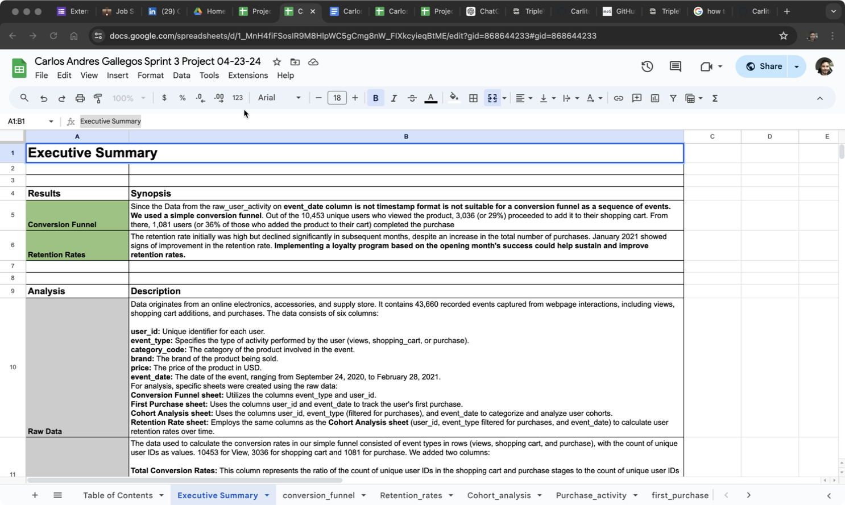
Executive Summary

Slide 4
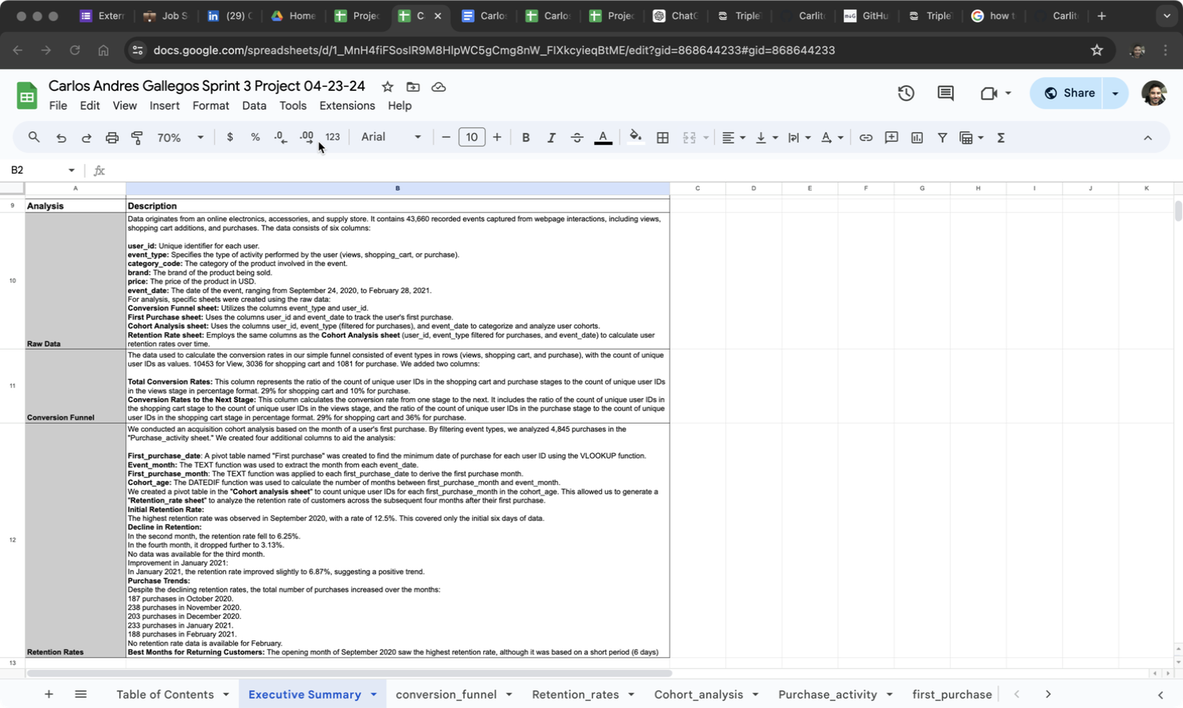
Analysis

Slide 5
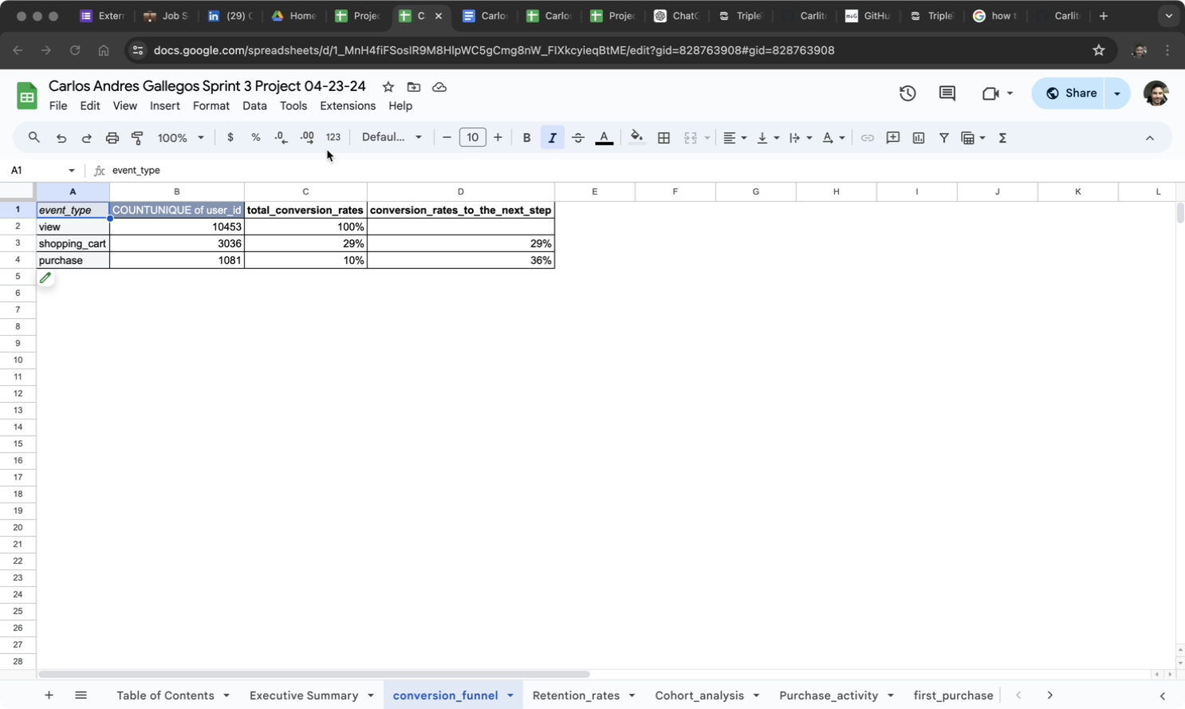
conversion_funnel

Slide 6
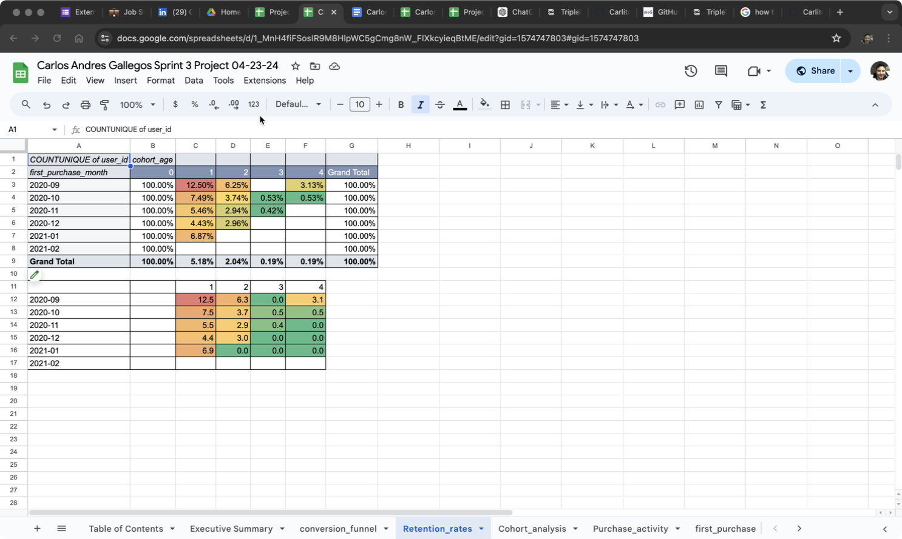
Retention_rates

Slide 7
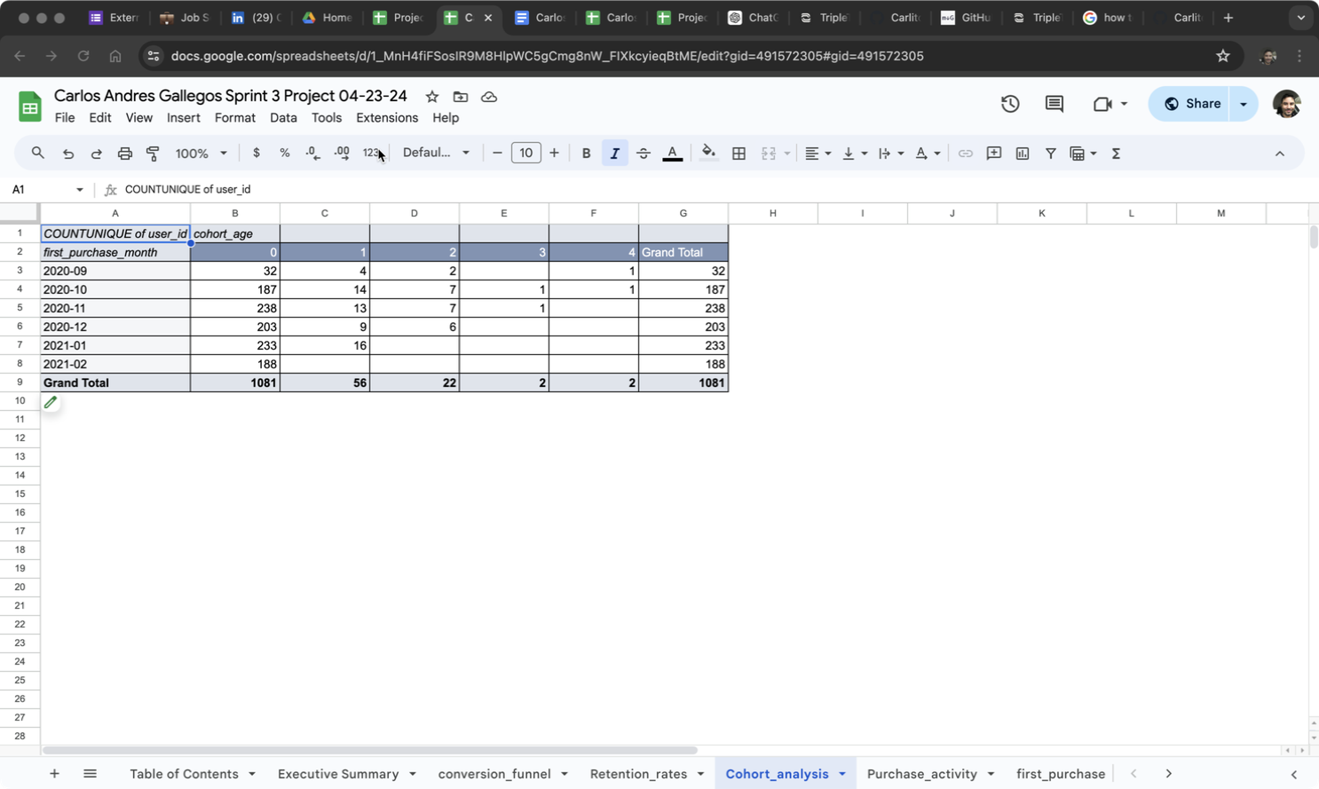
Cohort_analysis

Slide 8
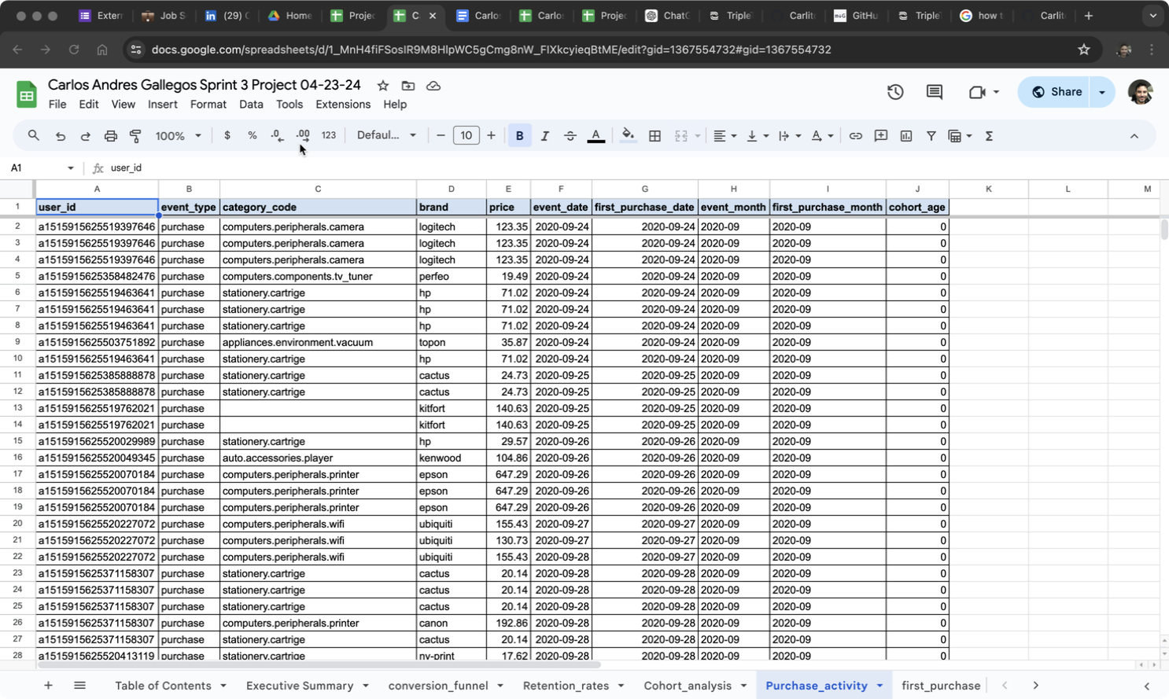
Purchase_activity

Slide 9
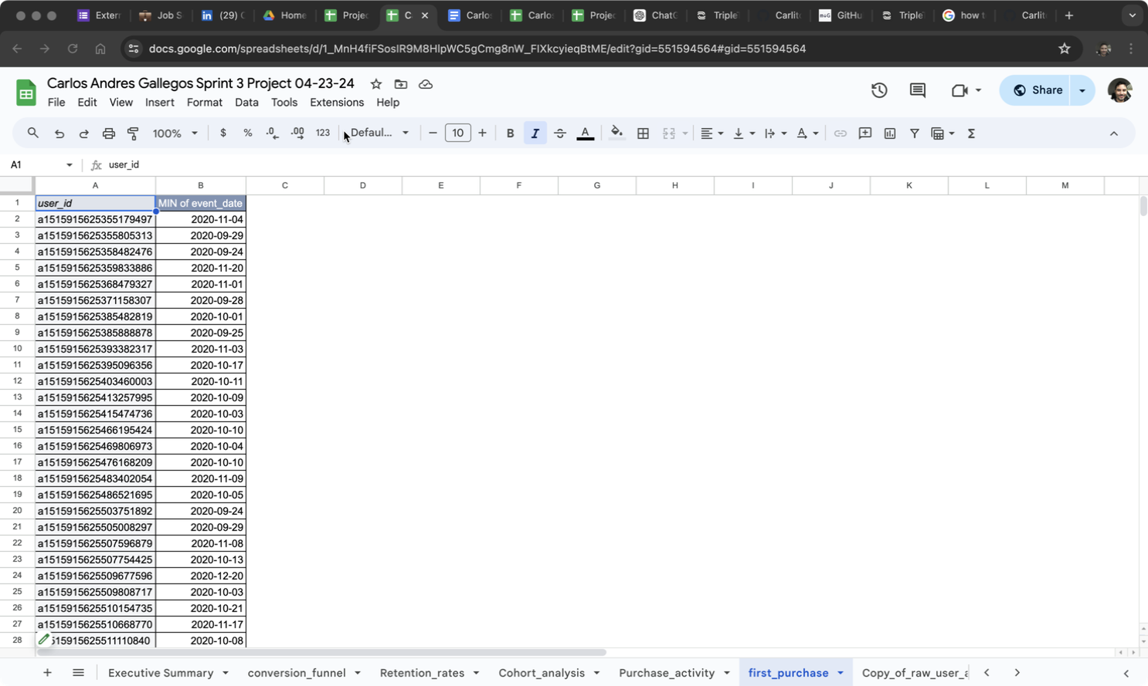
first_purchase

Slide 10
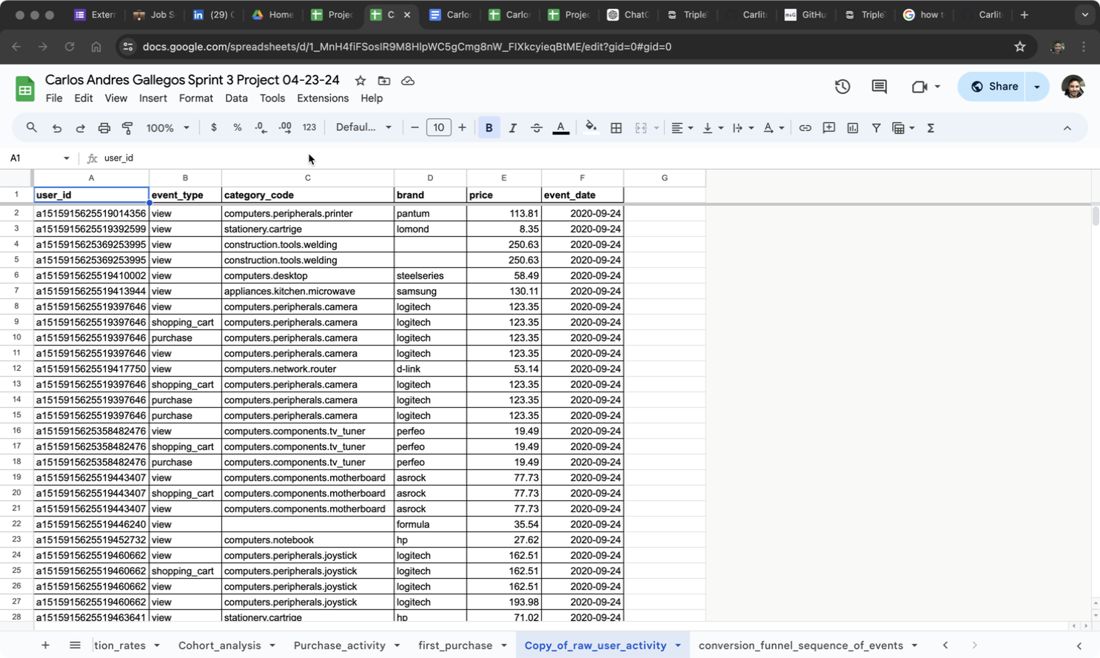
Copy_of_raw_user_activity

Slide 11
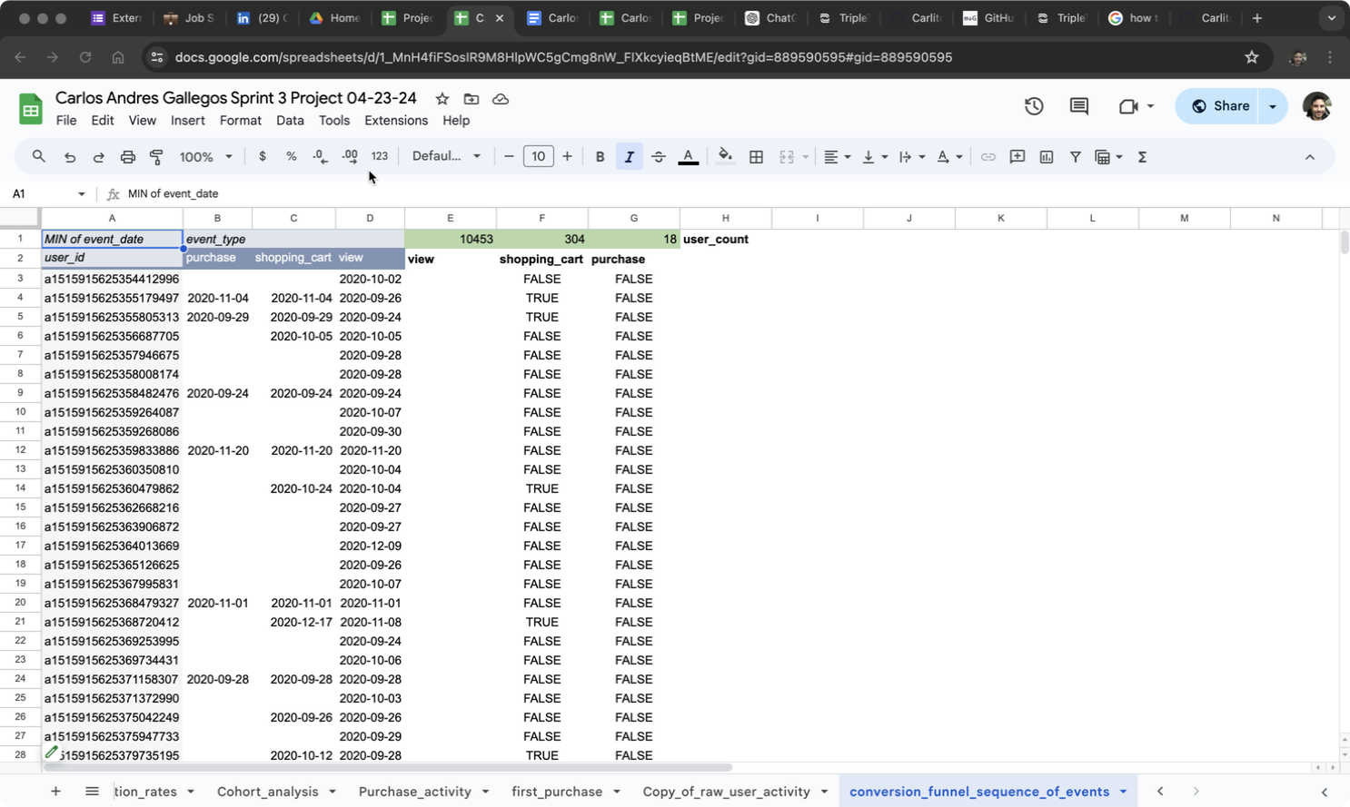
conversion_funnel_sequence_of_events

